Slide 1
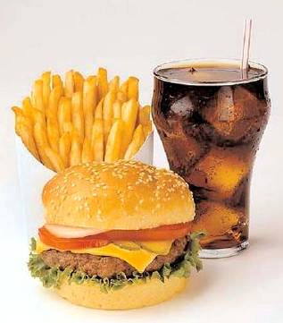
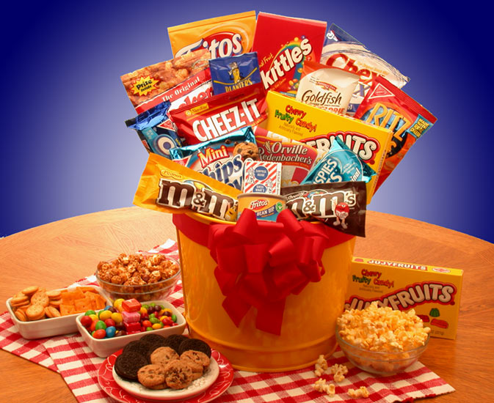
Junkfood / Fastfood
-Chips
-Chocolate
-Candy
-Food with low
nutrituion levels
-Food which is made
”fast”
-Microwave meals

Slide 2
Junkfood
Time factor
Taste factor
Junkfood advertising

Slide 3
McDonalds facts
an estimated one in every ten workers in the US has, at some point, been employed by the company
it is USA’s largest purchaser of beef, pork and potatoes and second largest of chicken (KFC is number one)
it operates more playgrounds - designed to attract children (and their parents) to its restaurants - than any other private entity in the US
the Golden Arches are now more widely recognized (especially to children) than the Christian cross
Notes:
58 million customers
daily - McDonald's revenues grew 27% over the three years ending in 2007 to $22.8 billion
0.433 per 10.000 capita

Slide 4
Fastfood effects
Increase the chance of getting type 2 diabetes
Mood svings
Sexual dysfunction
Liver damage
Hypertensions

Slide 5
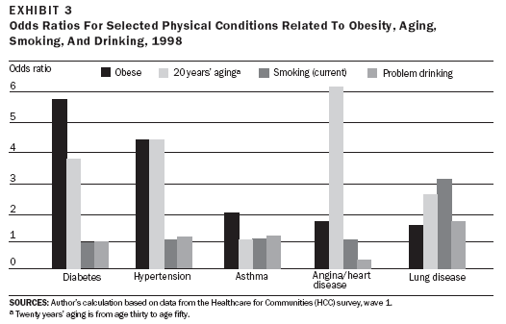
Sickness statistics

Slide 6
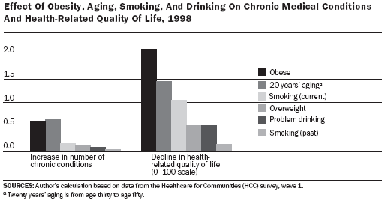
Health statistics

Slide 7
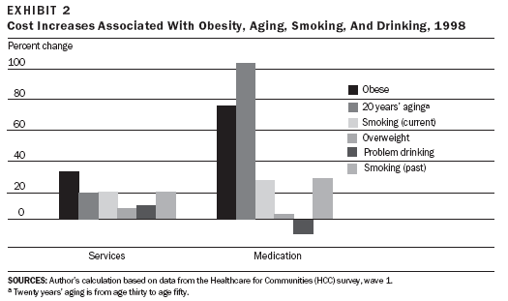
Economical increases

